Slide 1
R1 REINFORCEMENT LEARNING
Learning a greeting in MuJoCo
Cesar A. Pascal Vasquez
Notes:
Sources:
/Users/cesarpascal/Documents/Training/real_r1_arm_policy/rl_wave/experiment.py
/Users/cesarpascal/Documents/Training/real_r1_arm_policy/rl_wave/final_report.json

Slide 2
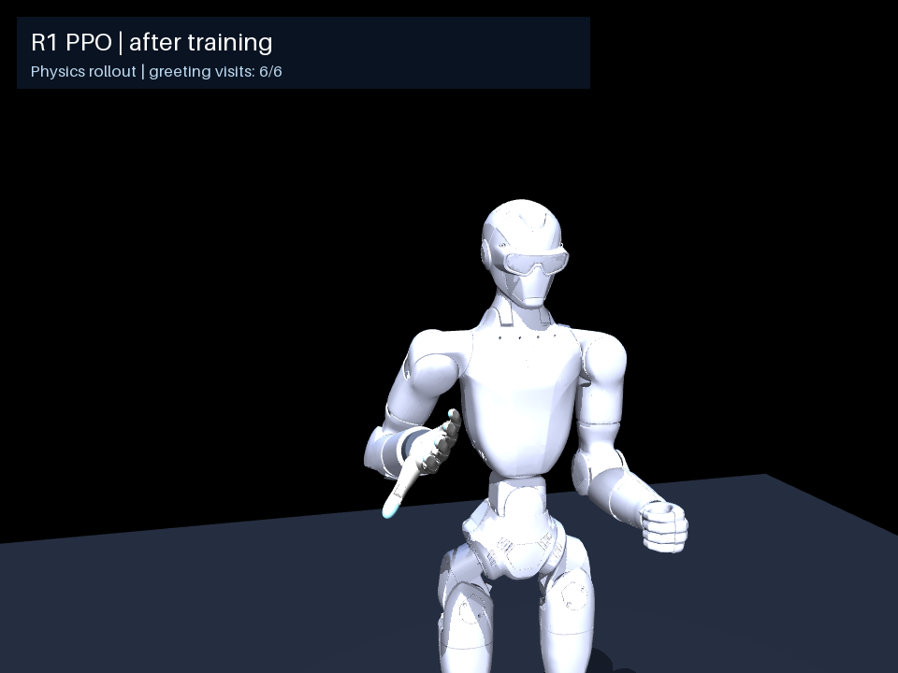
A learned greeting
A new policy learns to raise the right hand and make six alternating reaches.
Five arm joints move.
The body and open hand stay fixed.
Notes:
Sources:
/Users/cesarpascal/Documents/Training/real_r1_arm_policy/rl_wave/experiment.py
The experiment fixes the base and other joints. Whole-body stability and hand articulation are outside this test.

Slide 3
How the policy learns
1
The policy observes the arm and the hand’s target.
2
It chooses a movement for each of the five joints.
3
MuJoCo simulates the movement and calculates a reward.
4
PPO updates the policy to improve the next attempt.
Notes:
Sources:
/Users/cesarpascal/Documents/Training/real_r1_arm_policy/rl_wave/experiment.py
The reward scores target distance, palm orientation, six reach events and return. Penalties discourage abrupt actions, velocity and arm-to-torso contact. No scripted joint trajectory or demonstration policy supplies actions.

Slide 4
Training data
1
1,024,000 interactions generated in MuJoCo.
2
No real-R1 recordings or demonstration trajectories.
3
Four environments collect experience at 20 Hz.
4
Saved checkpoints, training logs and joint recordings.
Notes:
Sources:
/Users/cesarpascal/Documents/Training/real_r1_arm_policy/rl_wave/experiment.py
/Users/cesarpascal/Documents/Training/real_r1_arm_policy/rl_wave/training.jsonl
/Users/cesarpascal/Documents/Training/real_r1_arm_policy/rl_wave/before_training_joints.csv
/Users/cesarpascal/Documents/Training/real_r1_arm_policy/rl_wave/after_training_joints.csv
Raw training transitions were not archived. Saved evaluation CSVs contain 200 timestamps per policy.

Slide 5
Training setup
1
Start with a randomly initialized neural policy.
2
Reward reaching alternating targets near head height.
3
Increase completion bonuses after 716,800 steps.
4
Evaluate the final policy in 20 new test episodes.
Notes:
Sources:
/Users/cesarpascal/Documents/Training/real_r1_arm_policy/rl_wave/experiment.py
/Users/cesarpascal/Documents/Training/real_r1_arm_policy/rl_wave/training.jsonl
/Users/cesarpascal/Documents/Training/real_r1_arm_policy/rl_wave/final_report.json
PPO seed 614, two 128-unit hidden layers, 29 observations and 5 actions. First 716,800 steps used reach/return bonuses 8/5. Final 307,200 used intermediate/sixth/return bonuses 30/120/120. Learning rate 0.0003, batch 256, 6 epochs, gamma .98. Evaluation seeds 1500–1519.

Slide 6
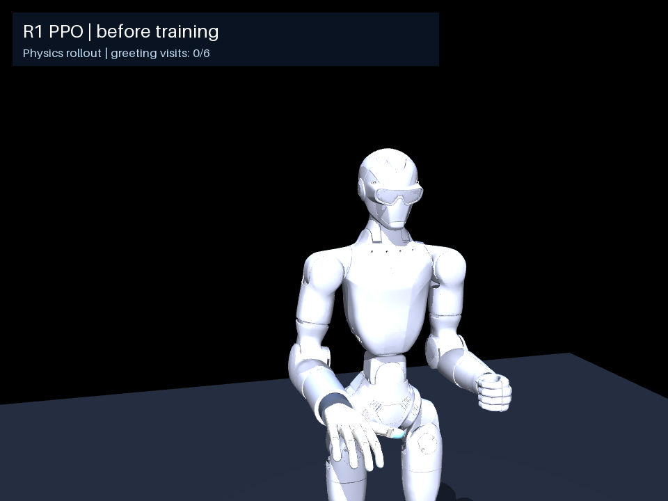
Before training
0 / 20
tests completing six reaches
0 / 6
mean completed reaches
Notes:
Sources:
/Users/cesarpascal/Documents/Training/real_r1_arm_policy/rl_wave/before_training.mp4
/Users/cesarpascal/Documents/Training/real_r1_arm_policy/rl_wave/final_report.json
Video seed 910, 10 seconds at 20 fps. Metrics are 20 fresh test episodes. The final policy completes six reaches but does not complete return to rest.

Slide 7
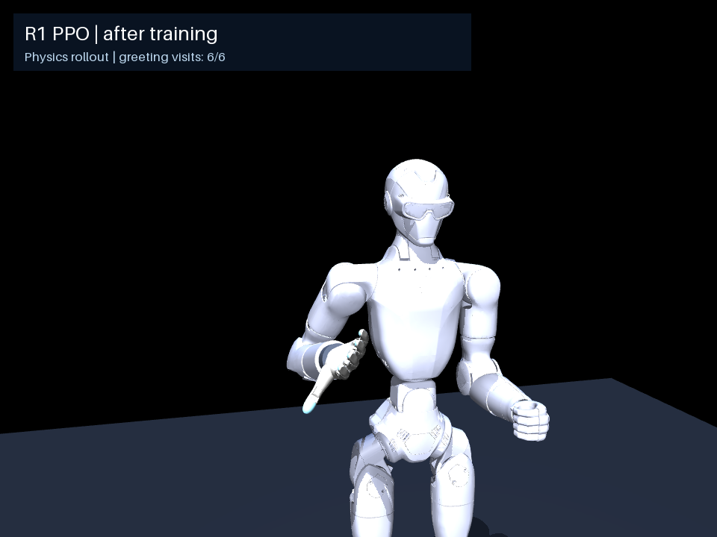
After training
20 / 20
tests completing six reaches
6 / 6
mean completed reaches
Notes:
Sources:
/Users/cesarpascal/Documents/Training/real_r1_arm_policy/rl_wave/after_training.mp4
/Users/cesarpascal/Documents/Training/real_r1_arm_policy/rl_wave/final_report.json
Video seed 910, 10 seconds at 20 fps. Metrics are 20 fresh test episodes. The final policy completes six reaches but does not complete return to rest.

Slide 8
Recorded joint movements stay within model boundaries
Right-arm joint | Model limits (rad) | Recorded range (rad)
Shoulder pitch | -3.142 to 2.094 | -0.676 to 0.597
Shoulder roll | -2.478 to 0.227 | -1.246 to -0.199
Shoulder yaw | -1.920 to 1.920 | -1.079 to -0.051
Elbow | -0.976 to 2.185 | -0.842 to -0.038
Wrist roll | -1.920 to 1.920 | -1.800 to -0.033
All 1,000 recorded joint positions are within the model limits.
Notes:
Sources:
/Users/cesarpascal/Documents/Training/real_r1_arm_policy/rl_wave/after_training_joints.csv
/Users/cesarpascal/Documents/Training/real_r1_arm_policy/rl_wave/after_training_audit.json
200 timestamps × 5 joints from a 10-second simulated rollout. All saved commands also fit model bounds. Rounded display values; calculations use full precision. Minimum margin 0.120149 rad. This is a sampled model position-bound check, not a physical hardware safety certification. Physical speed/torque limits, calibration, balance, collisions, latency and inter-sample peaks remain unverified.

Slide 9
Results
The trained policy completes six greeting reaches in all 20 test episodes.
Return to rest still needs improvement.
Real-robot validation is the next step.
Notes:
Sources:
/Users/cesarpascal/Documents/Training/real_r1_arm_policy/rl_wave/final_report.json
/Users/cesarpascal/Documents/Training/real_r1_arm_policy/rl_wave/after_training_audit.json
Return completion 0/20. No physical robot execution has been validated.

